Slide 1

NEET 2025: Coimbatore District Analysis
National Testing Agency performance dashboard
R. Mohanapriya

Slide 2

Problem Context
NEET exam is a highly competitive medical entrance exam where student performance determines eligibility for government and private medical colleges.
Educational institutions and coaching canters need to drive the students performance patterns, subject strengths, eligibility distribution, and career preferences.

Slide 3
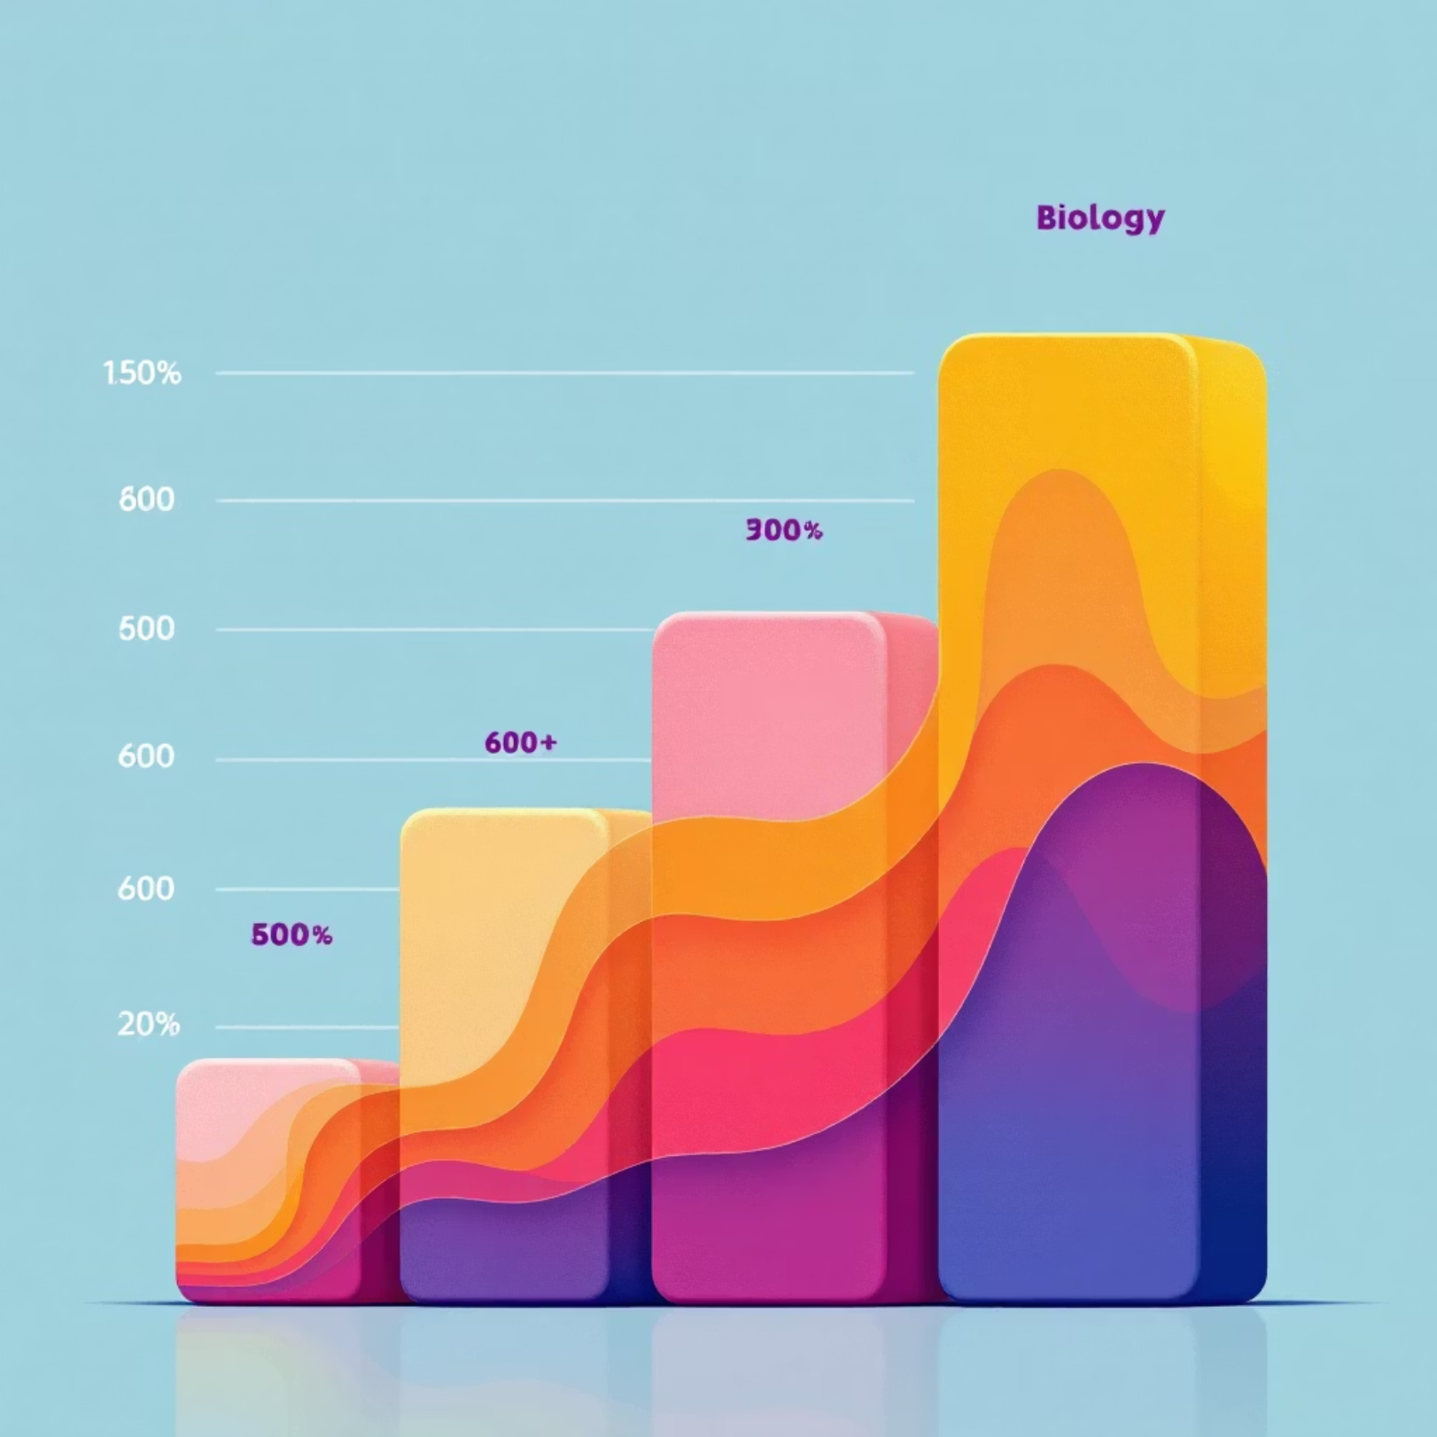
Key Findings- Performance Status
1) Biology is the highest-scoring subject among students, contributing significantly to total NEET marks.
2) Physics shows comparatively lower average marks, indicating it is most challenging subject for students.
3) A majority of the students fall within the 500-600 mark range, placing them near private college eligibility.
4) A small percentage of the students cross 600+ marks, which typically required for the government medical college admission.

Slide 4

Key Findings- Career Preference
1) Most students aim for MBS admission in government colleges due to lower tuition fees and higher prestige.
2) A significant number of students scoring 500-600 marks are likely to pursue private medical colleges.
3) Students with lower scores may consider alternative healthcare careers such as:
MBBS
BDS (Dental)
BAMS (Homeopathy)
Allied health sciences.
4)High-performing students with top AIR ranks have higher chances of securing seats in reputed government medical institutions.

Slide 5
Key Highlights
22.09L
18,692
665
27
Students Appeared
Coimbatore District
Top Score
AIR Rank
National level participation
Local examination centre
Out of 720 marks
All India Rank

Slide 6

District Champion
Soorya Narayanan S
Tamil Nadu 1st Mark
Score: 665 out of 720
AIR: 27
Category: UR/EWS

Slide 7
Category-wise Cutoff Marks
UR/EWS
OBC/SC/ST
UR/EWS/PWBD
686 - 144
143 - 113
143 - 127

Slide 8

Government College Eligibility
380
665.7
680
Eligible Students
Average Marks
Average AIR
Qualified for government college admission
Among eligible candidates
Rank of eligible students

Slide 9

Private College Eligibility
128K
336.3
164.7
Eligible Students
Average AIR
Average Chemistry Marks
Qualified for private college admission
Rank of eligible students
Among eligible candidates
164.6
336.3
Average Physics Marks
Average Biology Marks
Among eligible candidates
Among eligible candidates

Slide 10
Top Performers in Coimbatore
Student Name
Physics
Chemistry
Biology
Total
YASMIN M
177
174
332
661
Y SIVAANI
169
151
348
660
VIVEK KRISHNAA S
175
152
338
658
VISHVADHAR SHINI J
180
157
344
655
VISHAL V
165
180
343
651
VINISHA R
168
170
331
645

Slide 11


AIR Group Distribution
0.6%
12%
Top 1000
1001-5000
358 students
12 students
8%
2%
5001-10000
Above 10000
8 students
2 students

Slide 12
Subject-wise Performance
180
180
360
Maximum Physics
Maximum Chemistry
Maximum Biology
Highest score achieved
Highest score achieved
Highest score achieved

Slide 13

Study Hours vs Biology Marks
9
360
300
Average Study Hours
Maximum Biology
Average Biology
Per day
Score achieved
Score obtained

Slide 14

Strategic Recommendations
Based on survey , the following strategies can improve student outcomes:
Improve Physics Performance
Focus on Mid-Score Students
Coaching institutes should focus on:
students scoring 500-600 marks are very close to government eligibility. Focuses mentoring and additional revision could significantly improve their chances.
1)Concept-based problem solving
2)Regular mock tests
3)Targeted practice for difficult physics topics
Personalized Learning Plans
Data-Driven Academic Monitoring
Use performance data to create individual study strategies based on subject weaknesses.
Institutes should use analytics dashboards to track students progress and predict eligibility outcomes.

Slide 15

Future Endeavors
Year-wise NEET performance comparison
Study hours vs Score efficiency analysis
Predictive modeling for government eligibility
Student demographic analysis(age,gender,region)
Performance improvement tracking across mock tests.

Slide 16
Thank You

